Slide 1


Produce API .Net Core
MCC Trainers

Slide 2

Create Model
Define Attribute
1
Set Primary Key
2
Set Annotation Attribute for Validation
3
Set Table Name
4

Slide 3
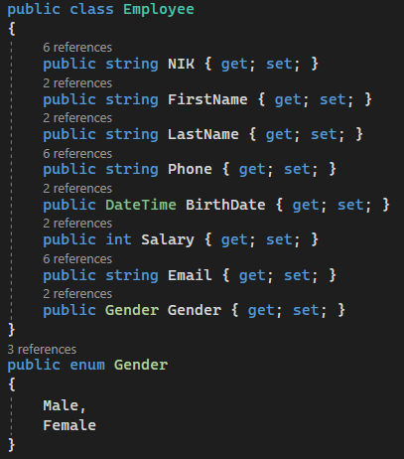
Define Attribute

Slide 4

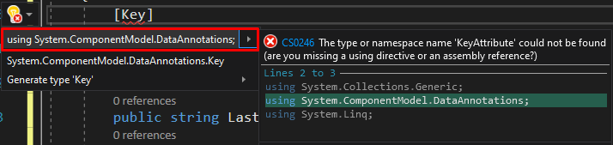
Set Primary Key
By Convention
Ex: Id, DepartmentId
Manually

Slide 5
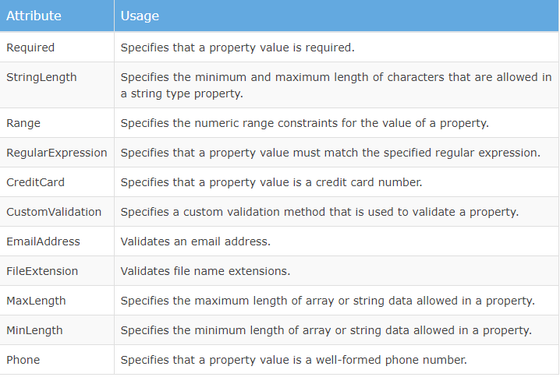
Set Annotation Attribute for Validation

Slide 6


Set Table Name

Slide 7
Road to implement model
Set Context
Set ConnectionStrings on appsettings.json
Set ConnectionStrings on Startup.cs
Migration (add-migration, update database)

Slide 8
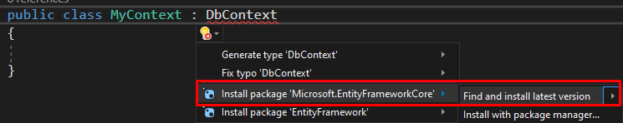
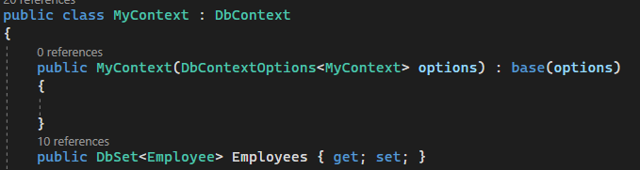
Set Context
Implement DbContext

Slide 9
What is Context?
Context is a gateway to our database. DbContext have 1 or more DbSet, which is represent table.

Slide 10
Set ConnectionStrings on appsettings.json
Consist of
Server
Database Name
User_Id
Password

Slide 11
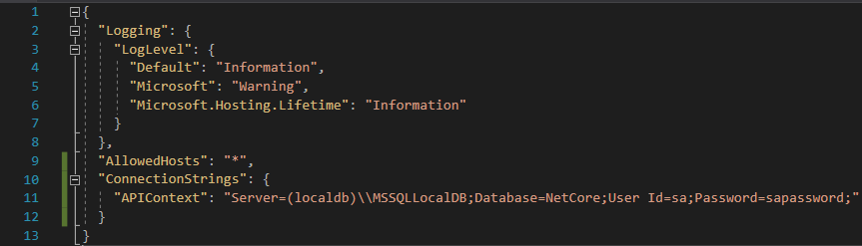

Slide 12
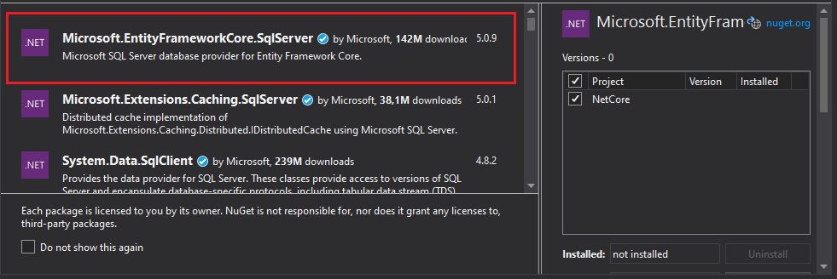
Make sure to install this first

Slide 13
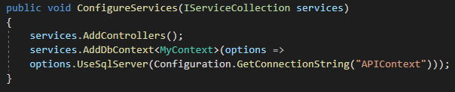
Set ConnectionStrings on Startup.cs

Slide 14
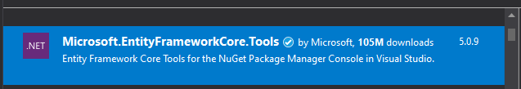
Migration (add-migration, update database)
Install package Microsft.EntityFrameworkCore.Tools

Slide 15

Add-migration
Add-migration + migration name
Rules:
As Identifier
Cannot contain space

Slide 16

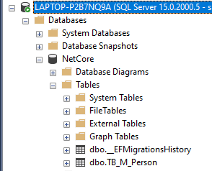
Update database
To implement changes
After that, check the database in SSMS

Slide 17
References
https://www.tutorialsteacher.com/mvc/implement-validation-in-asp.net-mvc

